Slide 1

SIT1302 Internet Programming
UNIT 1
MARKUP LANGUAGE
Ms.J.S.Vimali
SIT1302 School of Computing

Slide 2
Frameset and Frame elements
<html>
<head>
<title>Frames</title>
<frameset rows="30%,*">
<frame src="header.html" name="head">
<frameset cols="30%,*">
<frame src="frameone.html" name="one">
<frame src="frametwo.html" name="two">
</frameset>
</frameset>
</head>
</html>
SIT1302 School of Computing

Slide 3
header.html
<html>
<head>
<style>
body{
background-image:url('download.jfif');
background-repeat:no-repeat;
background-size: 100% 100%;
}
</style>
</head>
<body>
<b><center>Read - The Books store</center></b>
</body>
</html>
SIT1302 School of Computing

Slide 4
Frameone.html
<html>
<body bgcolor="#D4FF33">
<a href="welcome.html" target="_new">Welcome</a><br>
<a href="message.html" target="two">Message</a>
</body>
SIT1302 School of Computing

Slide 5
Frametwo.html
<!DOCTYPE html>
<html>
<head>
<style>
body
{
color:pink;
font-size:40pt;
}
</style>
</head>
<body bgcolor="(255,220,222)">
<i> We have offers for frequent customers</I>
</body>
</html>
SIT1302 School of Computing

Slide 6
Welcome.html
<!DOCTYPE html>
<html>
<body bgcolor="#ff00ba">
<p> We have books for
<ol>
<li>Engineering</li>
<li>Arts</li>
<li>Science</li>
<li>Fiction</li>
<li>Comics</li>
<li>MBBS</li>
<li>Management</li>
</ol>
</p>
</body>
</html>
SIT1302 School of Computing

Slide 7
Message.html
<html>
<head><style>
body{
color:#EFEFEF; font-color:cyan; background-color:lightgreen; font-size:25pt;}
</style></head>
<body><p> The architecture of the bookstore is reminiscent of the British Era and is one of the most beautiful places in Chennai to visit. The bookstore has high ceilings and the flooring is chequered design Italian marble. The interiors are beautiful with ornate stained glass work on the windows and over the doors, the white walls give the place an ancient yet classy look. Truly when you enter this place, you feel you have stepped back in time and maybe this is the reason that people keep coming here. This feeling of nostalgia cannot be offered by new age bookstores which are nothing but commercial hubs and have no unique identity of their own. Today one can see third generation of customers coming here to pick up their favourite books, this place has become like a home to many families over the decades.
</p>\</body></html>
SIT1302 School of Computing

Slide 8
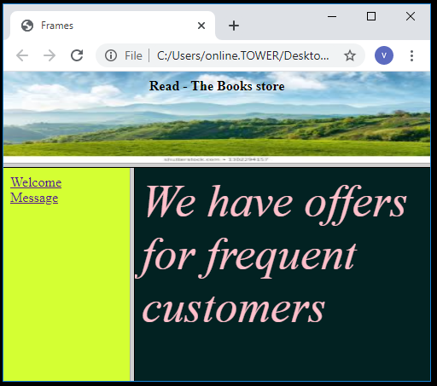
Output of Main page
SIT1302 School of Computing

Slide 9
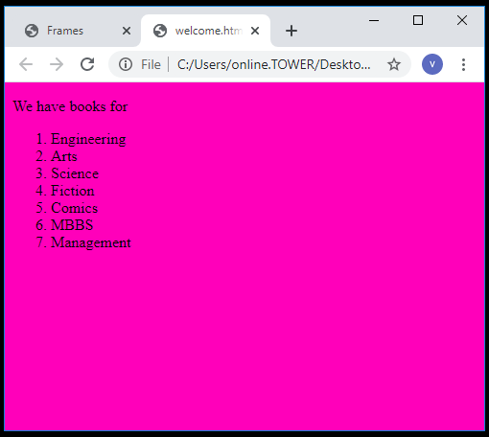
Welcome.html
SIT1302 School of Computing

Slide 10
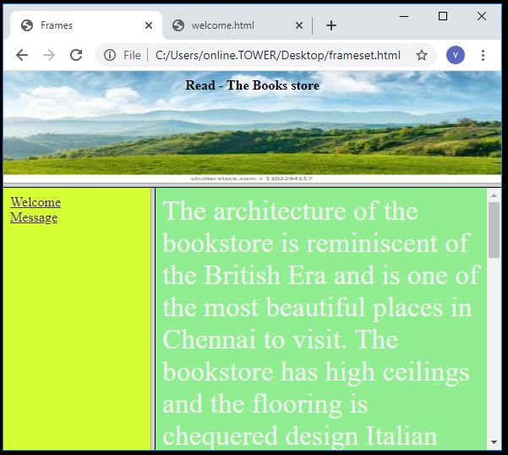
Message.html
SIT1302 School of Computing

Slide 11
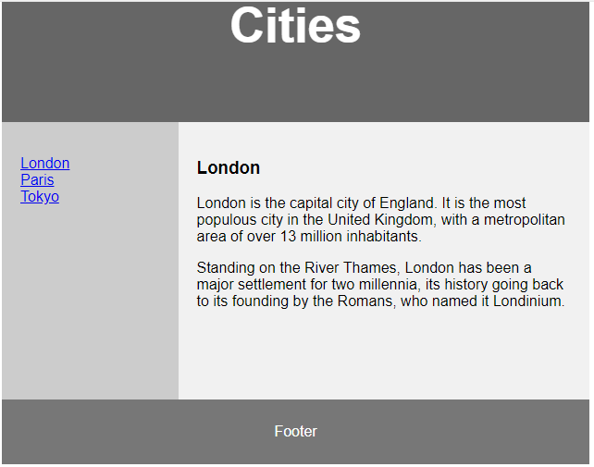
Write Frameset Division
SIT1302 School of Computing

Slide 12
HTML <form> Elements
The HTML <form> element can contain one or more of the following form elements:
<input>
<label>
<select>
<textarea>
<button>
<fieldset>
<legend>
<datalist>
<output>
<option>
<optgroup>
SIT1302 School of Computing

Slide 13
The <input> Element
One of the most used form element is the <input> element.
The <input> element can be displayed in several ways, depending on the type attribute.
<!DOCTYPE html>
<html>
<body>
<h2>The input Element</h2>
<form action="/action_page.php">
<label for="fname">First name:</label><br>
<input type="text" id="fname" name="fname"><br><br>
<input type="submit" value="Submit">
</form>
</body>
</html>
SIT1302 School of Computing

Slide 14
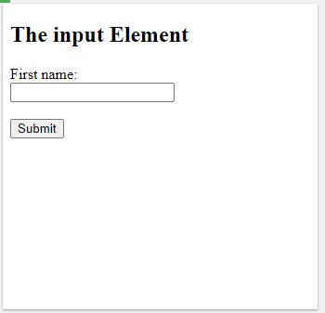
Output
SIT1302 School of Computing

Slide 15
The <label> Element
The <label> element defines a label for several form elements.
The <label> element is useful for screen-reader users, because the screen-reader will read out loud the label when the user focus on the input element.
The <label> element also help users who have difficulty clicking on very small regions (such as radio buttons or checkboxes) - because when the user clicks the text within the <label> element, it toggles the radio button/checkbox.
The for attribute of the <label> tag should be equal to the id attribute of the <input> element to bind them together.
SIT1302 School of Computing

Slide 16
The <select> Element
The <select> element defines a drop-down list
<!DOCTYPE html>
<html>
<body>
<h2>The select Element</h2>
<p>The select element defines a drop-down list:</p>
<form action="/action_page.php">
<label for="cars">Choose a car:</label>
<select id="cars" name="cars">
<option value="volvo">Volvo</option>
<option value="saab">Saab</option>
<option value="fiat">Fiat</option>
<option value="audi">Audi</option>
</select>
<input type="submit">
</form></body></html>
SIT1302 School of Computing

Slide 17
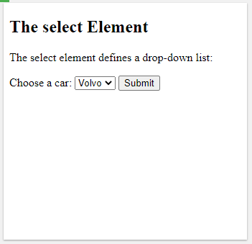
Output
The <option> elements defines an option that can be selected.
By default, the first item in the drop-down list is selected.
SIT1302 School of Computing

Slide 18
Visible Values
Use the size attribute to specify the number of visible values:
<!DOCTYPE html>
<html>
<body>
<h2>Visible Option Values</h2>
<p>Use the size attribute to specify the number of visible values.</p>
<form action="/action_page.php">
<label for="cars">Choose a car:</label>
<select id="cars" name="cars" size="3">
<option value="volvo">Volvo</option>
<option value="saab">Saab</option>
<option value="fiat">Fiat</option>
<option value="audi">Audi</option>
</select><br><br>
<input type="submit">
</form></body></html>
SIT1302 School of Computing

Slide 19
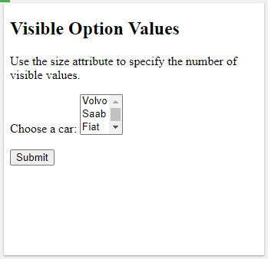
Output
SIT1302 School of Computing

Slide 20
Allow Multiple Selections
Use the multiple attribute to allow the user to select more than one value:
<!DOCTYPE html>
<html>
<body>
<h2>Allow Multiple Seletcions</h2>
<p>Use the multiple attribute to allow the user to select more than one value.</p>
<form action="/action_page.php">
<label for="cars">Choose a car:</label>
<select id="cars" name="cars" size="4" multiple>
<option value="volvo">Volvo</option>
<option value="saab">Saab</option>
<option value="fiat">Fiat</option>
<option value="audi">Audi</option>
</select><br><br>
<input type="submit">
</form>
<p>Hold down the Ctrl (windows) / Command (Mac) button to select multiple options.</p></body></html>
SIT1302 School of Computing

Slide 21
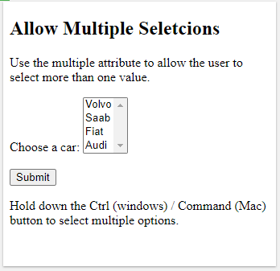
Output
SIT1302 School of Computing

Slide 22
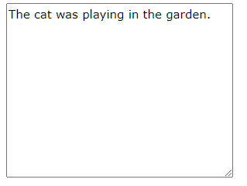
The <textarea> Element
The <textarea> element defines a multi-line input field (a text area)
The rows attribute specifies the visible number of lines in a text area.
The cols attribute specifies the visible width of a text area.
This is how the HTML code above will be displayed in a browser:
SIT1302 School of Computing

Slide 23
<!DOCTYPE html>
<html>
<body>
<h2>Styling Textarea</h2>
<p>Use CSS to change the size of the textarea:</p>
<form action="/action_page.php">
<textarea name="message" style="width:200px; height:600px;">The cat was playing in the garden.</textarea>
<br>
<input type="submit">
</form>
</body>
</html>
SIT1302 School of Computing

